Slide 1


Beyond Listings: Powering PropertyGuru's Data-Driven Future with AI
From Listings Portal to Singapore's Single Source of Truth
Sandeep Nathuram Kundalwal
Marketplace Seller – Trust (Ketan Parikh)
Notes:
Imagine a future where finding project insights in Singapore is as easy as asking a single question — no endless searches, no scattered data, just instant, trusted answers.
Good afternoon, everyone. I’m Sandeep Kundalwal from Marketplace Trust & Seller, and I’m excited to share a project that’s bringing us closer to that future: Beyond Listings: Powering PropertyGuru’s Data-Driven Future with AI. For years, PropertyGuru has been the go-to place for property listings — but our vision is much bigger. We’re on a journey to become Singapore’s single source of truth for everything related to real estate, and this initiative is a major leap toward that goal.

Slide 2
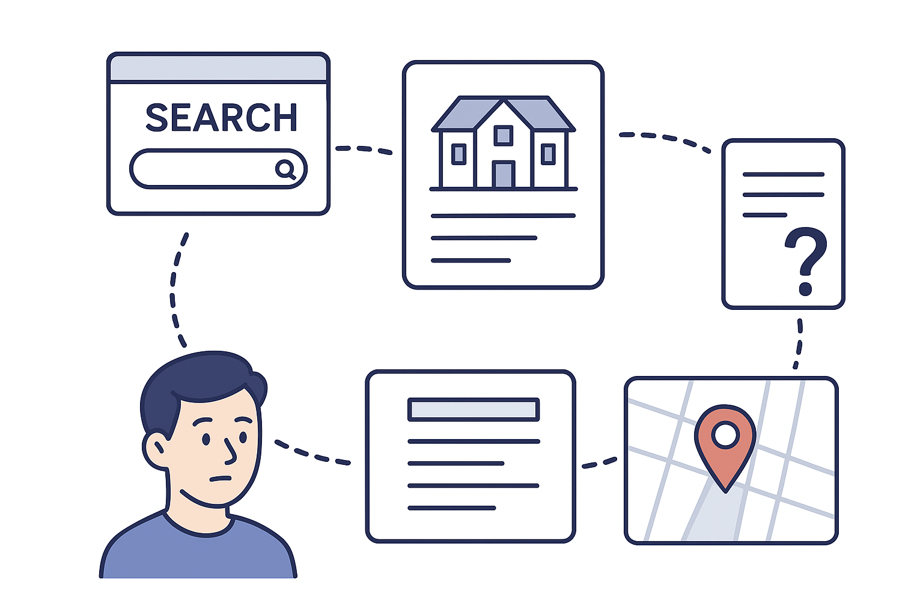



AI-Powered Project Insights
Problem Space
The Authority on Project Insights in Singapore Remains Vacant!
Fragmented Journey
Lack of confidence in decision-making for buyers, agents, or analysts
Lack of Context
Missing out on high-impact SEO gains.
03
Notes:
As we set our sights on becoming Singapore’s most trusted source for real estate information, we came across a clear gap: no one truly owns the space for project insights in Singapore. And this isn’t just a minor gap; it's a significant one with four major pain points.
Users—be it buyers, agents, or analysts—can't get a full, holistic picture of a real estate project from a single source. They have to manually piece together information from fragmented data sources.
Which leads to a frustrating user experience where individuals are forced to jump between multiple websites to gather all the information they need.
The result of this fragmented, incomplete information is a significant lack of confidence in decision-making.
Also from a business standpoint, this absence means we’re missing high-impact SEO wins that could drive significant organic traffic.

Slide 3




AI-Powered Project Insights
Solution space
Listings earned their trust. Insights will keep it!
One-Stop Shop
Confident Decisions
Context, Not Clutter
Transform Data into SEO-Driving Stories
04
Notes:
Our solution is simple yet transformative: a coordinated network of AI agents working together to deliver complete, reliable project insights. While our listings have already earned the trust of our users, it’s this next layer — rich, data-driven insights — that will sustain and strengthen that trust over time. Here’s how it works for our users and our business:
A One-Stop Shop: All project insights are centralized in a single platform, so users no longer have to hop between multiple sources.
Confident Decisions: By providing comprehensive, verified data, we are enabling confident decisions for every user, from first-time buyers to seasoned analysts.
Data-Driven Stories: We will leverage this rich data to generate unique, valuable content that transforms into powerful SEO-driving stories, significantly boosting our organic traffic.
Clarity Over Clutter: Finally, AI synthesizes complex information into clear, actionable insights — providing context without overwhelming users.

Slide 4
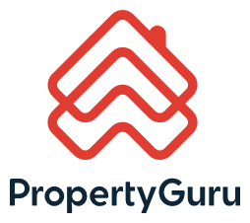







AI-Powered Project Insights
Solution Overview
An AI-Powered Agentic Pipeline to automate data retrieval and structure project insights.
An AI multi-agent system unifies property data from multiple sources
AI analyzes complex details to deliver actionable insights
Two dedicated AI agents guarantees data accuracy and integrity
[
{
”project": {
"core_property_unit_specifics": {
"project_overview": {
"data": {
"project_id": "23534", "project_type": "PROPERTY", "project_name": "Parc Esta", "project_display_type": "Condominium", "project_description": "822 Sims Avenue 400822,
Balestier / Geylang (D12-14)",
"property_type_group": "CONDO",
"district":"D14",
"developer_details": {
"name": "MCL Land Limited",
…
}
}
},
{“location_connectivity_amenities”: … },
{“market_performance_analysis”: … },
{“living_experience_management”: … },
{“competitive_landscape_analysis”: … },
{“agent_focused_insights”: … },
{“swot_analysis”: … },
{“key_considerations_actionable_advice”: … }
]
}
}
05
Notes:
The engine behind this solution is an AI-powered agentic pipeline, which is designed to automate the process of data retrieval, structuring, and insight generation.
At its core is a multi-agent AI system that brings together project data from a wide array of sources. This isn’t just a single AI — it’s a coordinated swarm of specialized agents, each with a defined role, working in unison.
Once the data is gathered, these agents analyze complex details, transforming raw information into clear, actionable insights that are easy for users to understand.
To ensure trust and reliability, we have two dedicated AI agents whose sole purpose is to guarantee data accuracy and integrity through a secondary validation process. This secondary check guarantees that every insight we deliver is not only comprehensive but also reliable.

Slide 5

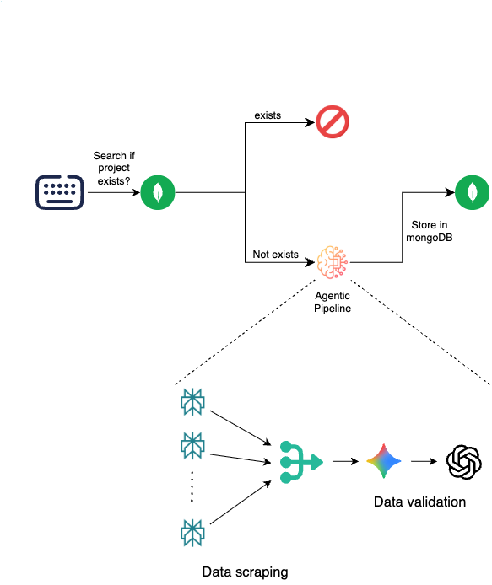




AI-Powered Project Insights
Architecture
Perplexity Node (Sonar Pro): Contextual web search.
Google Gemini Node (2.5 Pro): trained using large google dataset, long context processing.
OpenAI Node (GPT 4.1): precision and consistency through secondary validation.
06
Notes:
Now, before I dive into the demo, let me walk you through the architecture in a bit more detail.
The entire setup is powered by n8n, which acts as the engine behind all our workflows. Once the data flows through our two-step validation process, the verified insights are stored in database.
One thing I want to highlight here is that these insights are not fetched on-the-fly when users land on the project page. Instead, we pre-compute and store them, so that when a user comes in, they get instant, reliable access without any lag.
To make sure the information stays fresh, we can set up a cron job to automatically refresh the data at regular intervals, so that the users always have access to the latest insights.
The power of our pipeline is rooted in a three-node AI architecture. Think of it as a specialized relay team, where each agent has a different role.
Perplexity Node (Sonar Pro): The first agent in our pipeline is the Perplexity Node. It acts as our scout, performing contextual web searches to find the most relevant and up-to-date information.
Google Gemini Node (2.5 Pro): Next, the information is passed to Google Gemini Node. This agent is our powerhouse, specifically chosen for its ability to process long contexts and its training on the massive Google dataset.
OpenAI Node (GPT 4.1): Finally, the OpenAI Node serves as our quality control. It provides precision and consistency through a secondary validation step, ensuring the final output is accurate and reliable.
The outcome of this process is the rich JSON object, which contains all the structured project insights.
Why these nodes?
1 Perplexity Sonar Pro offers fast, real-time access to diverse, up-to-date web content through natural language queries. Unlike traditional scrapers, it provides AI-curated, summarized results with source citations, which reduces noise and improves the quality of raw input data.
2.Gemini 2.5 Pro has a massive context window and excels at broad, context-aware reasoning. It’s ideal for a first pass to detect missing data, perform schema alignment, and validate the general structure and semantics across large datasets scraped via Perplexity.
3.GPT-4.1 is highly reliable in factual consistency, language precision, and fine-grained validation. It’s perfect for catching edge cases, ensuring adherence to validation rules, and refining the output — especially where clarity, formatting, and accuracy matter most.
One liner: "I chose this stack to balance scale, context, and precision — with Perplexity for smart scraping, Gemini for scalable validation, and GPT-4.1 for surgical accuracy."
Why not use Gemini instead of perplexity?
Perplexity is optimized for web search and real-time retrieval — it’s designed to query, gather, and summarize fresh, diverse web content quickly, making it ideal as a scraping layer that pulls in broad, up-to-date information from multiple sources.
Gemini excels at deep reasoning and understanding but isn’t primarily a retrieval engine — it’s better suited for processing, validating, and analyzing structured or semi-structured data, not for continuously searching the web or pulling fresh data in real time.
Why not use openAI first and then Gemini?
“OpenAI models lack integrated real-time web search, so we use Perplexity first to fetch up-to-date data, then Gemini 2.5 Pro for scalable, context-aware validation — ensuring an efficient and accurate pipeline.”

Slide 6
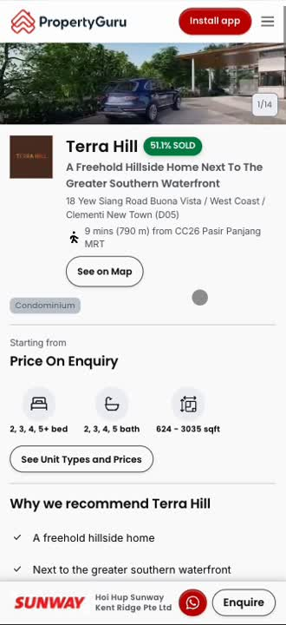
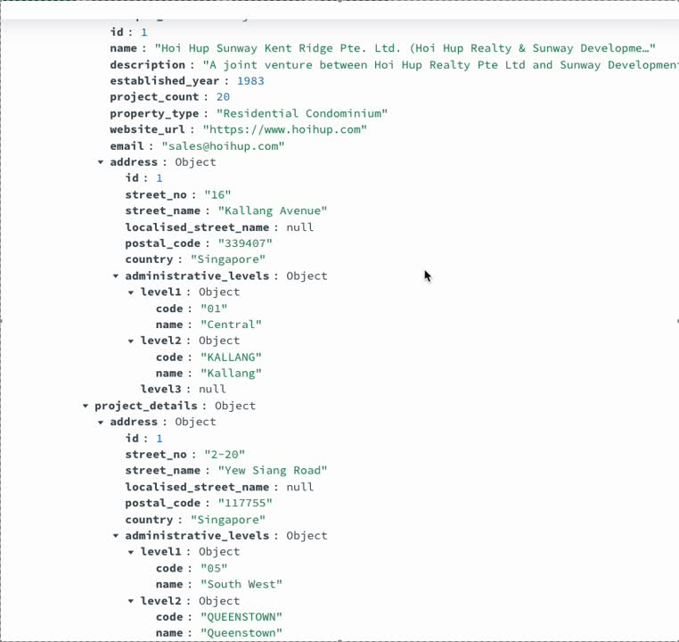
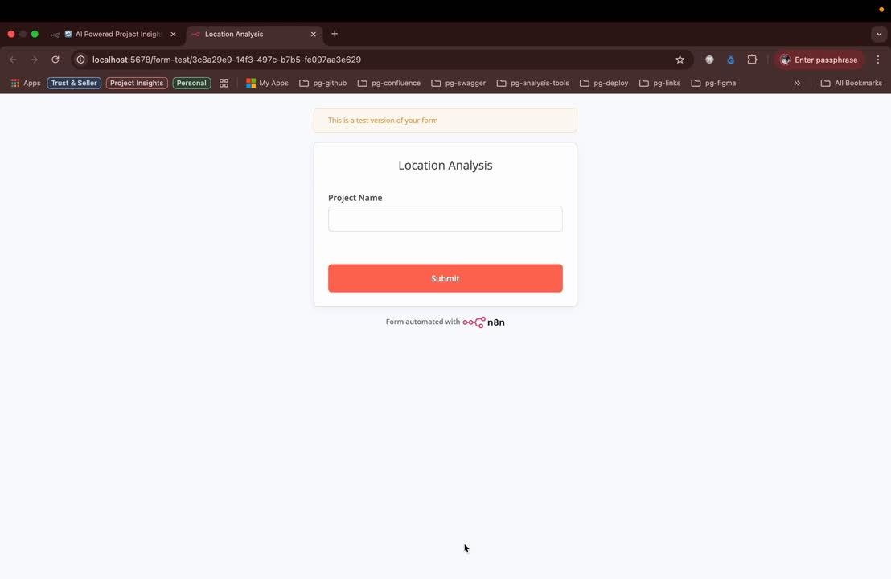
AI-Powered Project Insights
Demo Time
N8N Workflow
Data Stored in MongoDB
07
Notes:
We can show the percentage of units sold in these project, the floor plans (including the blocks), information related to each of the unit type like count, the parking spots and no. of EV Points, enhancing the data points in our POIs, details about recreational activities near the project like waterfronts, gyms etc, information related to demographics like the percentage of families, bachelors, senior citizens living in the whole project, the strength, weakness, opportunities & threats related to the project and then the key advisable insights for both the buyer and sellers like pricing factors, best time to sell and other information.
As you can see, what we have is a seamless, automated process that turns fragmented data into a cohesive and insightful narrative for our users.

Slide 7


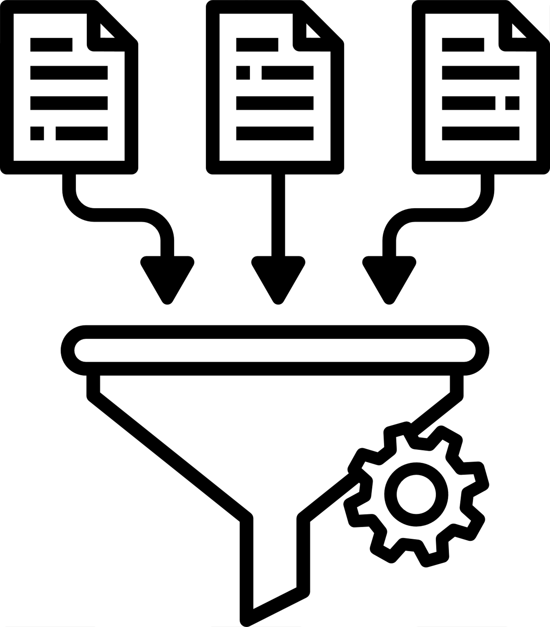


AI-Powered Project Insights
Business Impact
Establish PropertyGuru as the default destination for property data and insights
Single source of truth for every property decision
Property agents:
Pitch with authority
Analysts: Structured, ready-to-use insights for dashboards
Real estate buyers: Faster decisions, greater confidence
~45% more organic traffic
08
Notes:
The impact of this project will be felt across our entire ecosystem.
Property Agents, they will be able to pitch with newfound authority, backed by structured, data-driven insights.
Analysts will benefit from structured, ready-to-use insights that can be easily integrated into dashboards, saving them countless hours of manual work.
For our end users, this means faster and more confident decisions, a crucial part of the home-buying journey.
From a business standpoint, we project a gain of approximately 45% more organic traffic to our project pages.

Slide 8
AI-Powered Project Insights
Next Steps
1
2
3
4
LSOT Integration
Boost SEO Traffic
Launch Predictive Analytics
Deliver Personalized Insights
Collaborate with the Data COE team to merge our work with the LSOT data layer repository.
Partner with the SEO team to improve traffic to our project pages
Roll out predictive analytics to power smarter decisions
Generate unique project insights to begin personalizing the user experience.
09
Notes:
But our work doesn’t stop here. We have a clear and ambitious roadmap for the future. We are already actively syncing up with the Data COE team, and with the SEO Team to ensure this initiative aligns with our wider organizational goals.
LSOT Integration: Our first major step is to collaborate with the Data COE team to merge our work with the LSOT (Living Single Source of Truth) data layer repository.
Launch Predictive Analytics: Next, we will roll out predictive analytics to empower smarter decisions for our users.
Boost SEO Traffic: We will partner with the SEO team to further improve traffic to our project pages, leveraging the rich data we’re generating.
Deliver Personalized Insights: Finally, we will begin generating unique and personalized project insights to create a more tailored user experience.

Slide 9

Thank You
Notes:
With this I would like to thank my manager Ketan, my buddy Abhina, the leadership team and the talent acquisition Team for this wonderful opportunity. I am excited about the future of AI at PropertyGuru and let's continue help people make confident property decisions. Thank you.

Slide 10
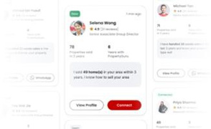
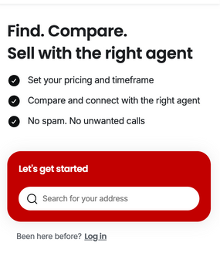
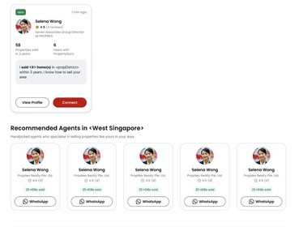
12 Months of Growth
At PropertyGuru
Cleared tech debts.
Secured homeowner GraphQL APIs.
Created salesforce flow to optimize mortgage agent selection.
Multiple design revamps.
Optimized APIs.
PGF Sunset.
Built Sell Landing Page.
End-to-end delivery within 3 weeks.
Built Seller Onboarding pages.
Integrated onboarding & agent status APIs.
Seller leads journey optimisation.
PRODI-G project.
SEP - FEB
MAR - APR
MAY - JUN
JULY - AUG
02
Notes:
From September to February, I was part of the PropertyGuru Finance. There, I worked on tech debts, secured Homeowner GraphQL APIs, and created a Salesforce (SF) Flow to optimize mortgage agent selection. I also worked on multiple design revamps and optimized APIs during this period.
From March till Mid April: Started with the new Seller Journey where I took the initiative of developing the whole Sell Landing Page on my own. Successfully delivering the whole within 3 week.
From May till Jun, continued with the Seller Leads Journey and worked on multiple onboarding pages, seller dashboard along with many of the major APIs like Seller Onboarding, and APIs related to Agent Cards.
And for the past 2 months, have been focused on optimizing the Seller Leads Journey by simplifying the onboarding process. And it was during this time that we officially kicked off with the project that I will be talking about today.

